Slide 1
Securitisation Risk Assessment
MEENA KARTHIKA

Slide 2
Project Overview
Objective of the project
Business problem
Importance of securitization risk analysis
IFRS 9 Expected Credit Loss (ECL)

Slide 3
Dataset Overview
Current Balance
EAD
CIBIL Score
DPD Bucket
Interest Rate
Borrower Age
Employment Type
Vehicle Type
IFRS Stage

Slide 4
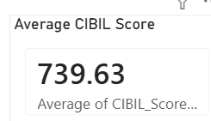
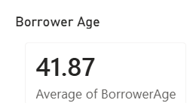
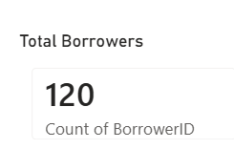

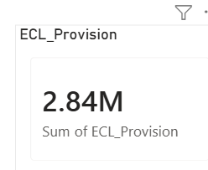
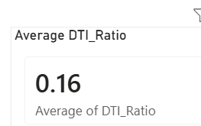
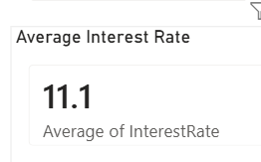
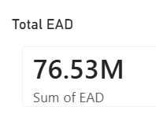
Dashboard Overview
KPI CARDS

Slide 5
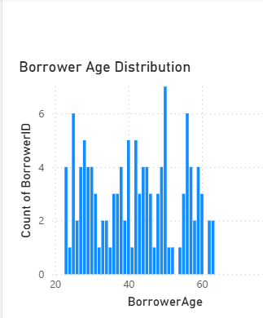
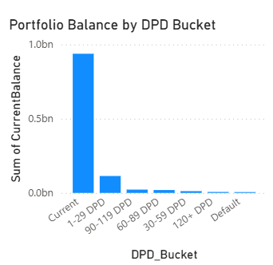
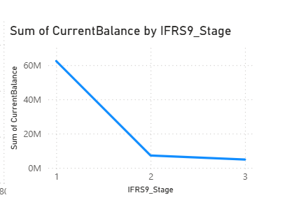
Charts
Borrower Age
IFRS 9 Stage
DPD BUCKET

Slide 6
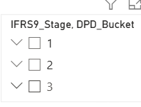
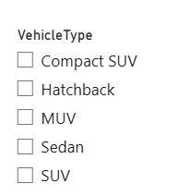
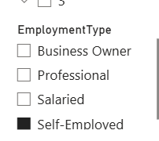
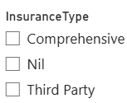
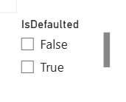
IFRS9 Stage , DPD Bucket
Vehicle Type
Employment Type
Insurance type
Defaulted
INTERACTIVE FILTERING

Slide 7
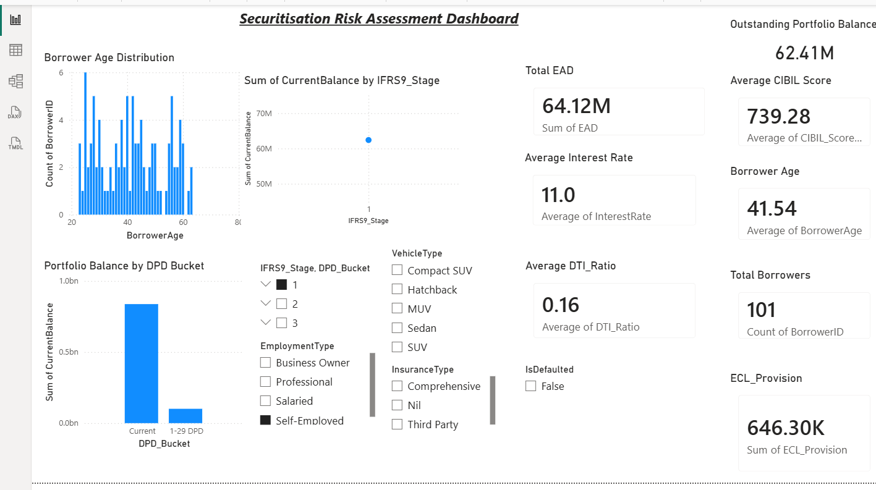
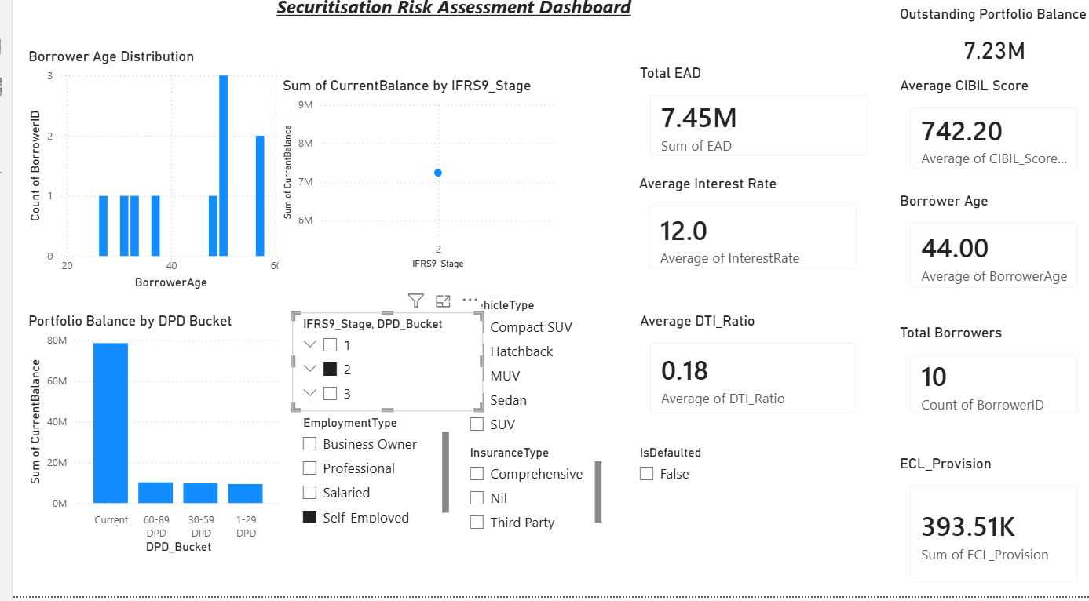
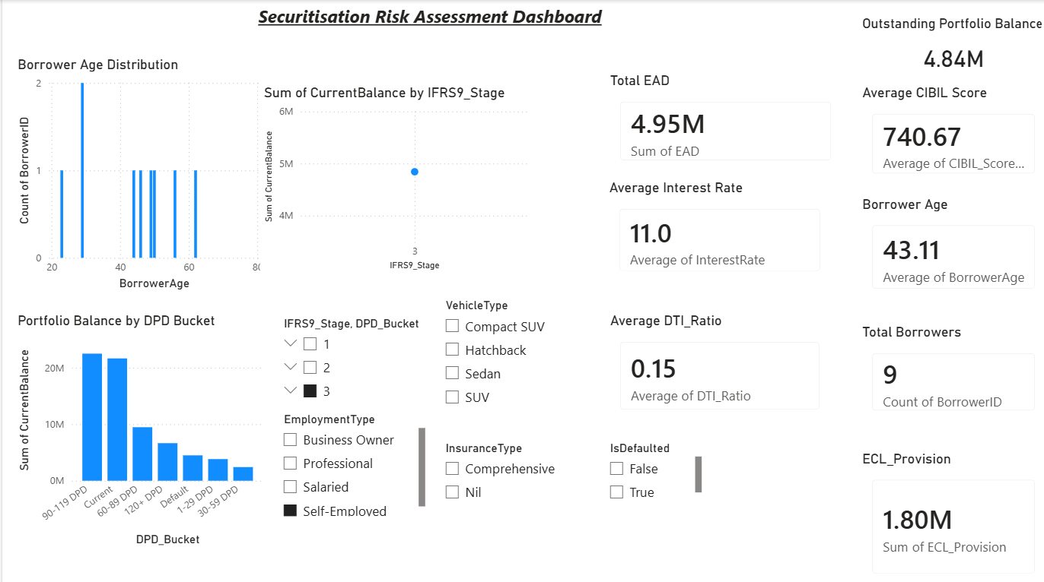
The IFRS Stage segmentation helps classify the loan portfolio based on credit risk deterioration:
Stage 1: Low credit risk, performing assets
Stage 2: Significant increase in credit risk
Stage 3: Credit impaired / defaulted assets

Slide 8
DPD Bucket Analysis
DPD (Days Past Due) buckets measure payment delay behavior across borrowers:
0–30 DPD: Healthy repayment behavior
31–60 DPD: Early stress signals
61–90 DPD: High-risk transition zone
90+ DPD: Default / NPA stage
👉 This analysis helps detect early delinquency trends and assess potential future credit losses before they fully materialize
Together, IFRS Stage and DPD Bucket analysis provide a dual-risk view:
IFRS Stage shows accounting-based credit risk classification
DPD Buckets show behavioral repayment risk
👉 This combination improves early warning detection, ECL forecasting, and portfolio risk management decisions.

Slide 9
DAX measures
Total Portfolio Balance
Total Portfolio Balance = SUM('Loans'[Loan Amount])
👉 Measures total outstanding portfolio size across all borrowers
Average Interest Rate
Avg Interest Rate = AVERAGE('Loans'[Interest Rate])
👉 Shows portfolio-level lending yield.

Slide 10
1.Majority Of Loans Belong To Stage
2.Higher DPD Buckets Show Increased Credit Risk.
3.Average CIBIL Indicates Overall Portfolio Quality.
4.ECL Identifies Expected Future Losses.
5.Interactive Dashboard Supports Management Decisions.
Business Insights

Slide 11
Conclusion:
1.Built an interactive securitisation dashboard.
2.Implemented IFRS 9 risk monitoring.
3.Created reusable DAX measures.
4.Enabled portfolio risk analysis.
Future Enhancements:
1.Live SAP integration
2.Azure SQL connection
3.Real-time dashboards
4.Machine learning default prediction

